Slide 1
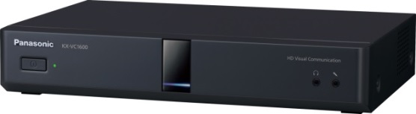
1. This document can be disclosed to Panasonic Sales Partners
2. The specs might be changed without notice since it’s still under development.
For Panasonic Sales Company and Business Partner only
Embedded MCU
(Multiple Connection Function)
Ver.4.20
Panasonic System Networks Co., Ltd.
Security System Business Division

Slide 2
History of Revision
Doc. Ver. | Contents | Date of Issue | Remarks
Ver. 4.00/4.10 | Issue of First Edition | Nov. 2014
Ver.4.20 | Add CP9 layout | Aug. 2015 | Page 11,12,13,21
Page 1

Slide 3


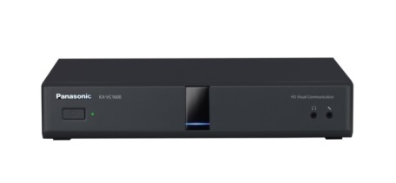

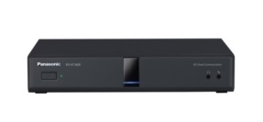
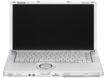


Embedded MCU Function
Max. up to 10 sites multiple connection can be made by HDVC system only with Star Connection Method.
Possible to make multiple connection including HDVC Mobiles and other VC systems.
Number of Max. Connection Site
  KX-VC1600: 6 sites (Can be upgraded up to 10 site)
  KX-VC1300: 4 sites
HDVC Mobile for iOS
Other VC system
VC1600
VC1600/VC1300
HDVC Mobile for
Android
HDVC Mobile for
Windows
VC500
VC600/VC300
VC600/VC300
VC1600/VC1300
Note: In case of connection by H.263 protocol (Old Generation Model), connection can be made up to 4 sites as maximum.
Page 2

Slide 4
Embedded MCU Function
Dialing and Disconnecting operation and behavior
Dialing operation and behavior of a main site and an endpoint are show below.
 | Dialing operation | Behavior | Remarks
Operation 1 | Making a call by selecting profile during non-communication (Dial out) | A call starts with a call received sites in turn. | Grouping of the plural endpoints (Registration can be made a profile.)
Operation 2 | Making a call by selecting the plural contact lists/call histories or direct input during non-communication (Dial out) | A call starts with a call received sites in turn. | A call with the one site or the group call can be made.
Operation 3 (Note 1) | Making an additional call from making a call screen during communication (Dial out) | A call received site is added.
Operation 4 (Note 1) | Receiving and answering a call from the endpoint which want to take part in the conference during communication (Dial in) | A site is add. (In case of using profile, judgment about profile condition is made before adding.) | Multi-point communication can be changed from 2-point communication.
(Note 1) Another profile call is prohibited using a profile.
Disconnecting operation and behavior at internal MCU are shown below.
 | Disconnecting operation | Behavior | Remarks
Operation 1 | Selecting one site to be wanted to disconnect from disconnecting screen during communication | That site will be disconnected after being selected.
Operation 2 | Selecting all sites to be wanted to disconnect from disconnecting screen during communication | Communication ends.
Operation 3 | Receiving a disconnecting notice by the sites which want to be disconnected during communication | The site which is disconnected will drop from a communication.
Page 3

Slide 5
Embedded MCU Function
Support for Multi Codec
Multi-codec communication is supported to keep AV quality when connecting to the endpoints which communicate at the different bandwidth simultaneously.
The maximum number of codec which can be used for transmission simultaneously is two.
Video Code |  | Video Quality
H.264 | High Profile (Non-interleave)
 | Baseline Profile (Non-interleave)
 | Baseline Profile (Single NAL)
H.263, H263+, H.263++ or H.261
Excellent
Poor
Support for the conference of plural endpoints with the different codec
  H.264 Baseline Profile (SingleNALU or Non-interleave) :
      HDVC mobile (Android / iOS), HDVC V2.2 / 2.3 / 2.4 / 3.0, the other VCs (H.264 Baseline Profile- compliant only)
  H.264 High Profile (Non-interleave) :
      HDVC V4.0/3.1, HDVC mobile (Win), The other company endpoint (H.264 High Profile-compliant)
Support for H.263++ / H.263+ / H.261 (Connectivity with the other company legacy endpoint is improved.)
Restrictions
  When dual stream is performed by the main unit, the main unit change the codecs to ones that all endpoints can receive for main / sub stream. If impossible it sends content by video source switching because it has two codecs only.
Page 4

Slide 6
Embedded MCU Function
Multi Codec Support (Available Combination)
Dual Stream Non-operation
Codec 1 | Codec 2 | Connecting status
H.264 HP | - | Connection with H.264 HP-compliant endpoints (HDVC Ver4.0, Ver3.1, etc.)
H.264 BP | - | Connection with H.264 HP non-compliant endpoints (HDVC Ver3.0 or less, etc.)
H.263(H.261) | - | Connection with H.264 HP-non compliant endpoints (Polycom VSX with high bandwidth setting, etc.)
H.264 HP | H.264 BP | Simultaneous connection with H.264 HP-non compliant endpoints and H.264 HP-compliant endpoints Codec 1: H.264 HP- compliant Codec 2：H.264 HP-non compliant (BP is compliant)
H.264 BP | H.264 BP | H.264BP-compliant endpoints are designated by RTP packetization (SingleNALU/non-interleave).
H.264 HP | H.263(H.261) | Connection with H.264 HP-compliant endpoints and H.264 non-compliant endpoints Codec 1: H.264 HP compliant site , Codec 2: H.264 non-compliant site
H.264BP | H.263(H.261) | Connection with H.264 HP non-compliant endpoints and H.264 non-compliant endpoints Codec 1: H.264 HP non-compliant site Codec 2: H.264 non-compliant site
Dual Stream Operation
Codec 1 | Codec 2 | Connecting status
H.264 HP | H.264 BP | All endpoints are H.264 HP-compliant endpoints (HDVC Ver4.0, Ver3.1 etc.)
H.264 BP | H.264 BP | In case of one or more H.264 HP non-compliant endpoint
H.264 BP | H.263 | In case of H.264 compliant endpoint and H263 (H261) compliant endpoint
H.263(H.261) | H.263 | In case of H.264 non-compliant endpoint and H263 (H261) compliant endpoint
  Note: If H.263 (H.261) non-compliant endpoint and H.264 non-compliant endpoint are connected simultaneously, the main unit sends the content using video source switching .
Page 5

Slide 7
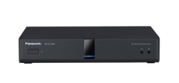



Embedded MCU Function
Available Video Codec by Endpoints
Video Codec | H.264 High Profile | H.264 Baseline Profile |  | H.263, H263+, H.263++, H.261
 | Non-interleave | Non-interleave | Single NAL
Endpoint
VC1600/VC1300
VC600/VC300 ～V3.0
HDVC Mobile
(Windows)
HDVC Mobile
(iOS, Android)
VC500
～V2.4
Other VCs
(SD systems)
VC600/VC300 V3.1
*There is systems that support H.264 High Profile and Baseline Profile with other VCs.
Sample System Configuration
VC1600/VC1300
VC1600/VC1300
Lower Group
Higher Group
Lower Group
Higher Group
H.264 Baseline Profile Group
H.264 High Profile Group
H.263 Group
H.264 High Profile Group
Page 6

Slide 8
Embedded MCU Function: Multi Codec Connection
Optimize the Video Quality depends on system performance.
<HD Resolution>
H.264 Baseline Profile
512kbps Bandwidth
<HD Resolution>
H.264 High Profile
768kbps Bandwidth
Lower Group
Higher Group
LTE/Wi-Fi/WiMAX
VC1600
2Mbps
VC1600/VC1300
512kbps
HDコム Mobile for iOS
2Mbps
VC1600/VC1300
Non Secondary Bandwidth
Settings
LTE/Wi-Fi/WiMAX
2Mbps
VC1600/VC1300
768kbps
HDVC Mobile for
Windows
512kbps
HDコム Mobile for
Android
1Mbps
VC500
2Mbps
VC600/VC300
2Mbps
VC600/VC300
  In case of Non Bandwidth settings, the system operation will be as follows.
    Higher Group: H.264 HighProfile or 264 BaselineProfile with Non-interleave mode
    Lower Group: H.264 BaselineProfile with SingleNAL mode
Two kinds of group will be operated depends on Bandwidth settings.
  Take lowest bandwidth among entire group.
  Available Video Quality (Include resolution) will be determined depends on bandwidth and system performance.
  Example: When HDVC Mobile for Windows is belonging in Higher group, available video quality of Higher group become HD resolution because HDVC Mobile for Windows does not support Full HD resolution.
Page 7

Slide 9
Embedded MCU Function: Multi Codec Connection
In case of Non Bandwidth settings (Non Dual Speed Settings)
VC1300 (FullHD)
H.264 HighProfile
4Mbps
HDVC Mobile for Windows (HD)
H.264 HighProfile
768kbps
HDVC Mobile for iOS (HD)
H.264 BaselineProfile / SingleNAL
512kbps
Other VC system (Full HD)
H.264 BaselineProfile / Non-interleave
1Mbps
VC300 (HD)
H.264 HighProfile
2Mbps
1. Depends on receiving performance of the devices, the system create two groups. (Upper group / Lower group)
Non Secondary
Bandwidth Settings
H.264 BaselineProfile / SingleNAL
HD
H.264 BaselineProfile / Non-interleave
HD
Higher Group
Lower Group
HDVC Mobile for iOS (HD)
H.264 BaselineProfile / SingleNAL
512kbps
HDVC Mobile for Windows (HD)
H.264 HighProfile
768kbps
VC1300 (Full HD)
H.264 HighProfile
4Mbps
Other VC system (Full HD)
H.264BaselineProfile
/ Non-interleave
1Mbps
VC300 (HD)
H.264 HighProfile
2Mbps
2. Take lowest bandwidth among the group.
512kbps Bandwidth
Higher Group
768kbps Bandwidth
Lower Group
HDVC Mobile for OS (HD)
H.264BaselineProfile/SingleNAL
512kbps
HDVC Mobile for Windows (HD)
H.264 HighProfile
768kbps
VC1300 (Full HD)
H.264 HighProfile
4Mbps
Other VC system (Full HD)
H.264BaselineProfile
/ Non-interleave
1Mbps
VC300 (HD)
H.264 HighProfile
2Mbps
Page 8

Slide 10
Embedded MCU Function: Dual Speed Connection
Optimize the Video Quality depends on available bandwidth and system performance.
<HD Resolution>
H.264 Baseline Profile
512kbps Bandwidth
<HD Resolution>
H.264 High Profile
1.5Mbps Bandwidth
LTE/Wi-Fi/WiMAX
Lower Group
Higher Group
Bandwidth: Narrow
VC1600
Bandwidth: Wide
2Mbps
VC1600/VC1300
512kbps
HDVC Mobile for
iOS
LTE/Wi-Fi/WiMAX
2Mbps
VC1600/VC1300
2Mbps
VC600/VC300
512kbps
HDVC Mobile for
Android
768kbps
VC500
768kbps
HDVC Mobile for
Windows
Secondary
Bandwidth Setting
Ex: 1Mbps
2Mbps
VC600/VC300
2Mbps
VC1600/VC1300
Two kinds of group will be operated depends on Bandwidth settings.
  Take lowest bandwidth among entire group.
  Available Video Quality (Include resolution) will be determined depends on bandwidth and system performance.
  Example: When HDVC Mobile for Windows is belonging in Higher group, available video quality of Higher group become HD resolution because HDVC Mobile for Windows does not support Full HD resolution.
Page 9

Slide 11
Embedded MCU Function: Dual Speed Connection
In case of 1Mbps setting
VC1300 (Full HD)
H.264 HighProfile
4Mbps
HDVC Mobile for Windows (HD)
H.264 HighProfile
768kbps
HDVC Mobile for iOS (HD)
H.264 BaselineProfile / SingleNAL
512kbps
VC300（HD）
H.264 HighProfile
2Mbps
Other VC system (Full HD)
H.264 BaselineProfile / Non-interleave
1Mbps
1. Depends on Bandwidth settings, the system create two groups. (Upper group / Lower group)
Secondary Bandwidth Setting: 1Mbps
512kbps Bandwidth
1Mbps Bandwidth
Lower Group
Higher Group
HDVC mobile for Windows (HD)
H.264 HighProfile
768kbps
HDVC Mobile for iOS (HD)
H.264BaselineProfile / SingleNAL
512kbps
VC1300 (Full HD)
H.264 HighProfile
4Mbps
Other VC system (Full HD)
H.264BaselineProfile
/ Non-interleave
1Mbps
VC300 (HD)
H.264 HighProfile
2Mbps
2. Take lowest codec among the group.
H.264 BaselineProfile / SingleNAL
HD
H.264 BaselineProfile / Non-interleave
HD
Lower Group
Higher Group
HDVC Mobile for Windows (HD)
H.264 HighProfile
768kbps
HDVC Mobile for iOS (HD)
H.264BaselineProfile / SingleNAL
512kbps
VC1300（FullHD）
H.264 HighProfile
4Mbps
VC300（HD）
H.264 HighProfile
2Mbps
Other VC system (Full HD)
H.264BaselineProfile
/ Non-interleave
1Mbps
Page 10

Slide 12
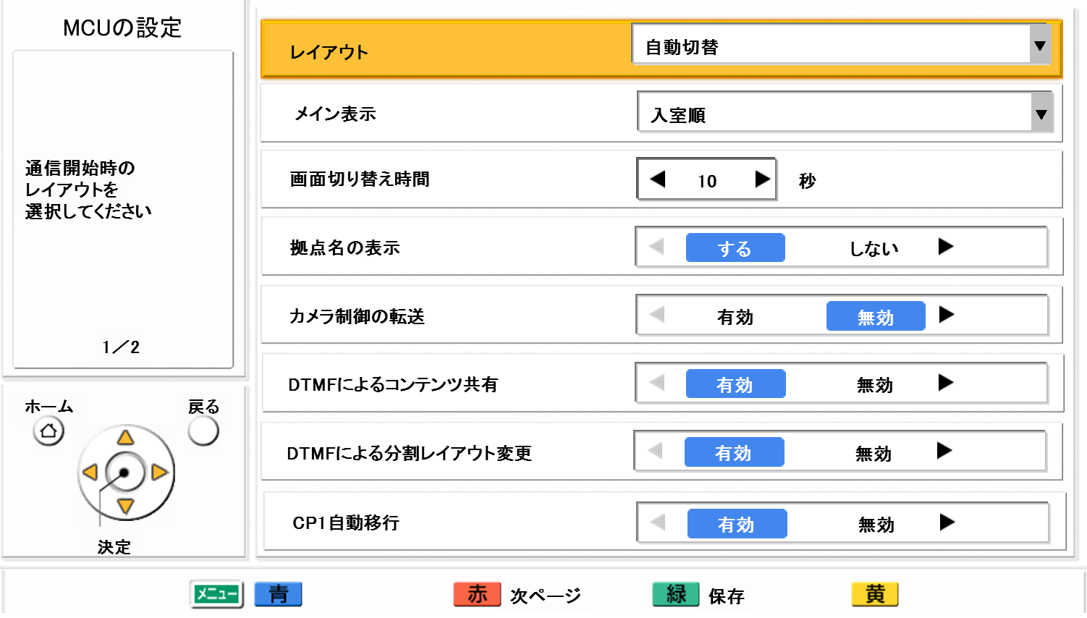
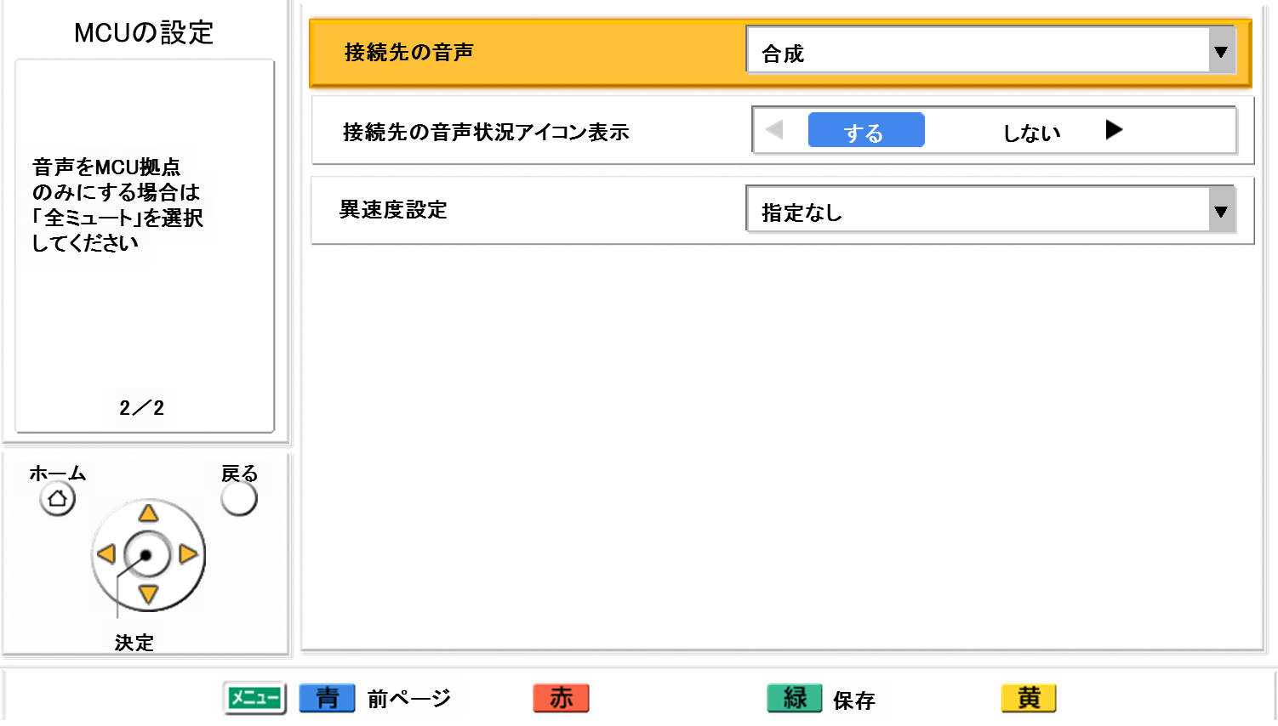
Setting of Dual Speed Connection
Go to “Menu” => “Settings” => “MCU Settings”
Setting Menu of MCU (First page)
MCU Settings
Screen Layout
Setting Item | Setting Value
Screen Layout | Auto / CP1 / CP2 / CP4 / CP6 / CP8 / CP9 / CP10
The Main Position | Voice Detection 1 Voice Detection 2 Local Site
Voice switch time frame | 10 sec. (Default)
Site name display | ON / OFF
Camera control transmitting | ON / OFF
DTMF for Contents Sharing | ON / OFF
DTMF layout change | ON / OFF
Auto move to CP1 | ON / OFF
The Main Position
Voice Switch Time Frame
Site Name Display
Camera Control Transmitting
DTMF for Contents Sharing
DTMF Layout Change
Auto move to CP1
Setting Menu of MCU (Second page)
MCU Settings
Other Site’s Audio
Setting Item | Setting Value
Other Site’s Audio | Mix Mute
Display far site’s Mute icon | ON / OFF
Secondary Bandwidth Selection | Not Specified 2Mbps or more 1Mbps or more 756kbps or more 512kbps or more 256kbps or more
Display far site’s Mute Icon
Secondary Bandwidth Selection
Page 11

Slide 13

Screen Layout
The followings are available screen layout of the embedded MCU.
Layout mode | Auto | Fixed CP1 / CP2 / CP4 / CP6 / CP8 / CP9 / CP10
 | The screen layout is automatically changed depends on number of connection site. | The screen layout will be fixed depends on settings.
Screen Layout
CP1
CP2
CP4
CP6
No.1 position
No.1 position
1
1
2
1
2
No.1 position
No.1 position
1
2
3
3
4
4
5
6
CP8
This is new!
CP9
CP10
No.1 position
1
2
3
1
2
No.1 position
1
2
No.1
position
3
4
5
6
4
3
4
5
6
5
6
7
8
7
8
9
7
8
9
10
Screen layout while in conference will be same at all sites. (Impossible to change layout at each site)
By remote controller or GUI menu, screen layout operation mode can be set and change at base site.
At remote site, screen layout can be changed by DTMF of the remote controller. (In case of fixed screen layout only)
Page 12

Slide 14
Setting of Screen Layout
When “AUTO” mode is selected, the screen layout is automatically changed depends on number of connection site.
# of site | 2 | 3～4 | 5～6 | 7～8 | 9 | 10
Screen Layout | CP1 | CP4 | CP6 | CP8 | CP9 | CP10
Note: Screen position will be determined depends on connection order.
Setting Menu of MCU (First page)
MCU Settings
Screen Layout
Setting Item | Setting Value
Screen Layout | Auto / CP1 / CP2 / CP4 / CP6 / CP8 / CP9/CP10
The Main Position | Voice Detection 1 Voice Detection 2 Local Site
Voice switch time frame | 10 sec. (Default)
Site name display | ON / OFF
Camera control transmitting | ON / OFF
DTMF for Contents Sharing | ON / OFF
DTMF layout change | ON / OFF
Auto move to CP1 | ON / OFF
The Main Position
Voice Switch Time Frame
Site Name Display
Camera Control Transmitting
DTMF for Contents Sharing
DTMF Layout Change
Auto move to CP1
Page 13

Slide 15
Voice Synthesis
Voice Synthesis
Other Site’s Audio | Mix | Voice of the 4 highest voice level sites is synthesized and returned to each site.
 | Mute | Voice of only Main site is retuned to each site.
Setting Menu of MCU (Second page)
MCU Settings
Other Site’s Audio
Setting Item | Setting Value
Other Site’s Audio | Mix Mute
Display far site’s Mute icon | ON / OFF
Secondary Bandwidth Selection | Not Specified 2Mbps or more 1Mbps or more 756kbps or more 512kbps or more 256kbps or more
Display far site’s Mute Icon
Secondary Bandwidth Selection
Page 14

Slide 16
Voice Activation
Voice Activation
  Camera screen position of MCU (Divided combined screen) is changed by detecting voice level of each site.
  It remains for the holding time (Default: 10 seconds), once it is switching.
The Main Position *1 | Voice Activation | Highest voice level site in the all sites: Display in No.1 position
 | Site Designation | Designated site (Local, Remote) will be in top light position: Display in No.1 position
 | Voice Activation 2 | Display Local site (MCU site) in No.1 position, highest voice level site in the all sites will be in No.2 position.
*1: Site of the highest voice level in the all sites is moved to the
No.1 position.
It is possible to set screen layout and display priority separately.
The system operate as follows depends on settings.
  CP1: Default
  CPn: Keep screen layout as is.
Voice activation cannot operate in case of contents sharing with
Single stream by video source switching.
No.1 position
The highest voice level is detected.
No.1 position
Exchange
××××
(The highest voice level)
Page 15

Slide 17


Voice Activation (Operation by setting mode)
Voice Activation Mode
Voice Activation (Normal) | Highest voice level site will be in top left position: Display in No.1 position
 | Screen Layout (Connection site: Up to 4 sites)
 | Screen Layout (Connection site: More than 5 sites)
No.1 position
No.1 position
1
2
1
2
3
4
3
4
Highest voice level
No.1 position
No.1 position
1
2
1
2
Highest voice level
Non-displayed site
3
4
5
3
4
5
Note: Voice activation cannot operate in case of contents sharing with Single stream by video source switching.
(Contents image will be displayed in No.1 position as priority)
Page 16

Slide 18
Voice Activation (Operation by setting mode)
Site Designation Mode
Mode 1 (Site Designation) | Designated site (Local, Remote) will be in top light position. Set designated site in profile setting before starting conference. Setting change can be made while conference.
 | Screen Layout (Connection site: Up to 4 sites)
 | Screen Layout (Connection site: More than 5 sites)
No.1 position
No.1 position
1
2
1
2
Designated site
Designated site
3
4
3
4
Highest voice level
No.1 position
No.1 position
1
2
1
2
Designated site
Highest voice level
Non-displayed site
Designated site
3
4
5
3
4
5
Note: Voice activation cannot operate in case of contents sharing with Single stream by video source switching.
(Contents image will be displayed in No.1 position as priority)
Page 17

Slide 19
Voice Activation (Operation by setting mode)
Voice Activation 2 Mode
Mode 2 | Display Local site (MCU site) in No.1 position, highest voice level site in the all sites will be in No.2 position.
 | Screen Layout (Connection site: Up to 4 sites)
 | Screen Layout (Connection site: More than 5 sites)
No.1 position
No.1 position
1
2
1
2
MCU site
MCU site
3
4
3
4
Highest voice level
No.1 position
No.1 position
1
2
1
2
MCU site
Highest voice level
Non-displayed site
MCU site
3
4
5
3
4
5
Note: Voice activation cannot operate in case of contents sharing with Single stream by video source switching.
(Contents image will be displayed in No.1 position as priority)
Page 18

Slide 20
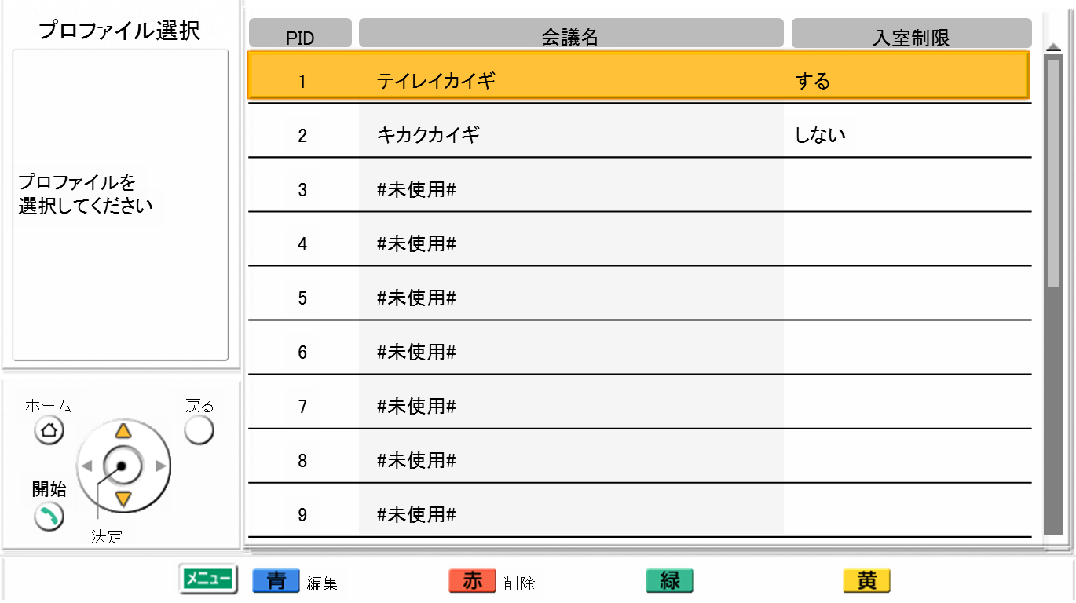

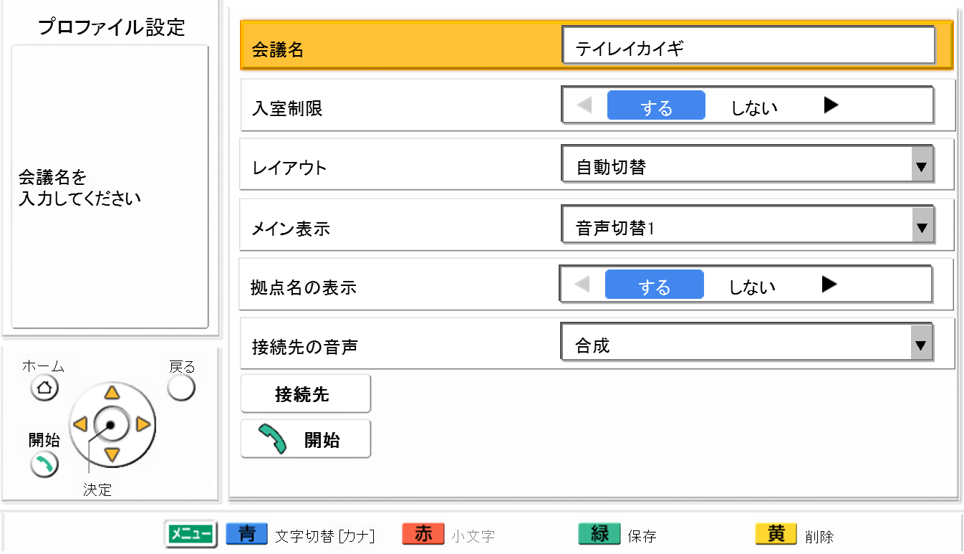

Profile Settings
The user can create profiles of meeting based on the need for each meeting.
    < Contents of the profile >
    20 profiles can be set
    Name of meeting, Address of participants, prohibits other participants, screen layout, the main position (the main site/selected site/voice activation/hybrid), display site name (enable/disable), Synthesized audio (auto/main site only)
Go to “Menu” => “Profile”
Profile List
[ In case prohibiting other participants ]
The site not
registered
Setting Menu
Profile
Group
Entry Restriction
Cannot Join
Screen Layout
The Main Position
Site Name Display
Other Site’s Audio
Prevents unexpected sites participate the meeting.
The profile is available for both of dial in and simultaneous dial out from the Main Site.
If some of the participants did not answer the call, set down the specific profile, then dial again to the non-answered participants.
Page 19

Slide 21
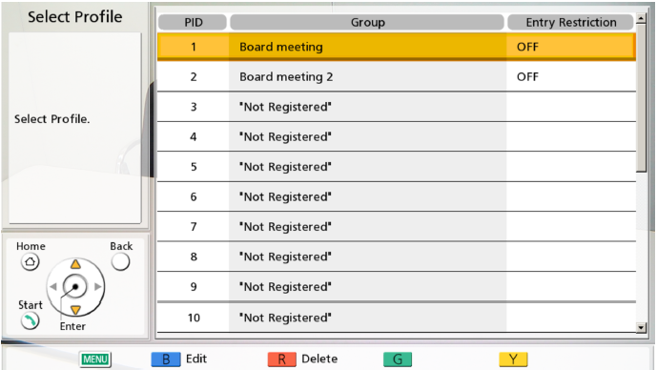
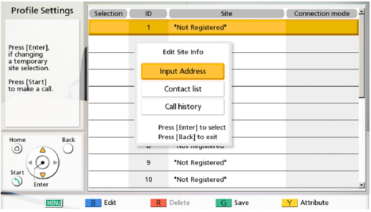
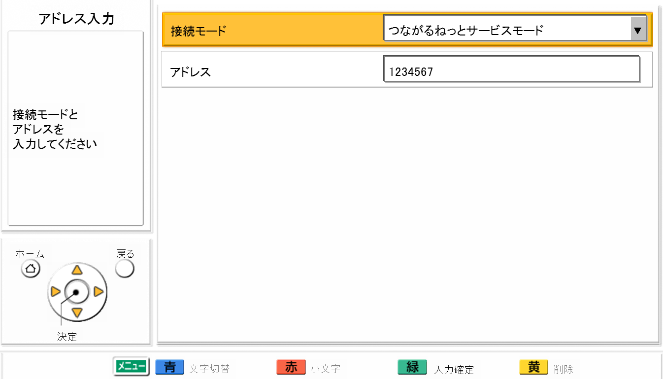
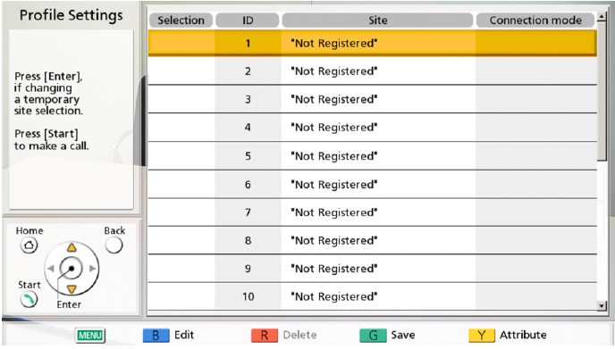
Profile Settings
Site selection screen of the Profile (Display up to 20 sites)
* Above message display when pressing “Blue” (Edit) button.
Screen of Address input
Home Menu of Registered Profile List
Address Input
Connection Mode
Address
Setting Item | Setting Value
Connection Mode | IP Mode (SIP) IP Mode (H.323) NAT Traversal Mode
Address | * Input specific IP Address
Page 20

Slide 22
Embedded MCU Function
DTMF Receiving Detection
DTMF receiving detection (Content sharing)
  As legacy HDVC does not support dual stream transmission, it sends PC content by video source switching. So, the displayed position of PC content at CPn layout is not fixed. Therefore, auto-move of PC content to the No.1 position and auto-transition to screen layout CP1 are performed by DTMF form endpoints.
  Note) Auto-transfer to screen layout CP1 can be set ON/OFF by internal MCU setting. (default :ON)
  DTMF code of sharing content is *10, that of releasing is *11.
  When main unit receives notification of content sharing, control authority is passed to the endpoint which has sent notification of content sharing. Content sharing mode is transferred by single stream (video source switching).
  If control authority has been already passed to an endpoint, it will be passed to another endpoint which send notification of content sharing later.
  In this case voice activation does not operate, the endpoint that sent code *10 is displayed at No.1 position.
  Control authority is automatically released and content sharing mode is also released when disconnecting the site which has a control authority.
  Main unit maintains dual stream even if code *10 is received during dual stream and the endpoint that sent its code is moved to No.1 position. At this time, screen layout is up to main site settings. Screen layout is returned to the previous layout if code *11 is received.
  The setting that do not allow the DTMF detection can be set by internal MCU setting.(Default: Detectable)
DTMF receiving detection (Screen layout change)
  Screen layout can be changed from CP1 to CP10 by DTMF from all endpoints.
  DTMF code :
  The setting that do not allow the DTMF detection can be set by internal MCU setting. (Default: Detectable)
Layout | CP1 | CP2 | CP4 | CP6 | CP8 | CP9 | CP10
Keypad | *21 | *22 | *24 | *26 | *28 | *29 | *20
Page 21

Slide 23
Embedded MCU Function
Other Functions
Other internal MCU setting
  Camera control transferring function (ON/OFF), CP1 layout transferring when sharing content (ON／OFF), DTMF for content sharing from endpoint (Permitted, Ignored), DTMF for layout control from endpoint (Permitted, Ignored), Display of endpoint name (ON/OFF), Holding time of main screen at Voice activation (1-20s)
Contact list
  Only single address can be registered in the contact list.
    Maximum number of contact list : 600
    Connecting mode shall be designated (IP mode (SIP), IP mode (H.323), NAT traversal mode), when registered. (Default: IP mode (SIP))
Profile
  A profile that can be registered conference attributes and connection endpoints is introduced for group call and security of the conference.
    Number of profile: 20
    Number of registered connecting endpoint : 20
    Conference attributes : conference name, access control limitation (ON/OFF), Screen layout (Fix/Auto), Main screen (Registered site, Voice Activation, Voice Activation 2), display of endpoint name (ON/OFF), Voice synthesis setting (Synthesis/Mute)
  Dial out using a profile list
Call history
  Call history is shown per each endpoint. < Call history: 50 calls >
  Adding a profile to outgoing call history and calling using this history.
Direct call
  Calling using a profile
  Calling by entering an address directly
  Calling from the contact list
  Calling from the call history
Page 22

Slide 24

Thank You !
Panasonic System Networks Co., Ltd.
Security System Business Division

