Slide 1
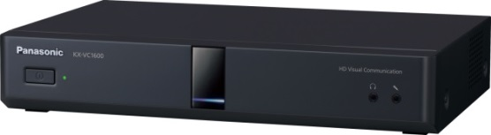
1. This document can be disclosed to Panasonic Sales Partners
2. The specs might be changed without notice since it’s still under development.
For Panasonic Sales Company and Business Partner only
Dual Stream and Multi Display
Ver.4.20
Panasonic System Networks Co., Ltd.
Security System Business Division

Slide 2
History of Revision
Doc. Ver. | Contents | Date of Issue | Remarks
Ver. 4.00/4.10 | Issue of First Edition | Nov. 2014
Ver. 4.20 | Add Selection for Content Sharing Method Data sharing method can be selected while communication | Aug. 2015 | Page 05
Page 1

Slide 3

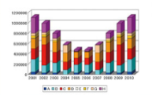









Dual Stream and Multi Display
Support H.239 (H.323) and BFCP (SIP) to make Dual Stream possible
Possible to simultaneous transmission of Main Camera Image and PC Contents (or Sub-camera Image)
VC1600 supports triple monitor, and dual for VC1300.
In case of single monitor, composited image (PC Contents + Remote site image) can be displayed into one monitor.
Basic Pattern of Dual Stream
Main Camera Image + PC Contents or Main Camera Image + Sub-camera Image.
Impossible to transfer Sub-camera Image and PC contents at same time.
Possible to change screen layout during connection, such as Sub-camera + Sub-camera and PC Contents + PC Contents
Sub-camera
Image
PC Contents
Remote site
Local site
or
Local site
PC
Contents
HDMI1
HDMI2
HDMI3
HDMI1
HDMI2
Main（HDMI）
Main（HDMI）
Main Stream : Main Camera Image
Sub-stream : Sub-camera Image or PC Contents
Sub（HDMI）
VC1600J
VC1300
Main Stream : Main Camera Image
Ratio of Allocated Rate for Camera Image and PC Contents
Possible to set from GUI
Setting Ratio (Camera : Contents) = 5:5 / 3:7 / 7:3 *Default: 5:5
PC In
（RGB/HDMI）
Page 2

Slide 4
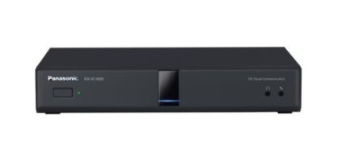

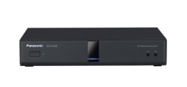


Dual Stream
Requirement for Dual Stream
All equipment must be supported Dual Stream Function.
Dual Stream : YES
Single Stream (Dual Stream : Non Support)
VC1600/VC1300
VC1600/VC1300
Base Site
Base Site
Remote Site
Remote Site
・・・
・・・
・・・
・・・
VC1300
(Dual Stream Supported)
VC600/VC300
(Dual Stream Supported)
VC1300
(Dual Stream Supported)
VC500
(Dual Stream Non-supported)
Other VC System
(Dual Stream Supported)
Other VC System
(Dual Stream Non-supported)
Base Site / Main Stream: Main Camera Image
Main Site / Main Stream: Main Camera Image or Sub-camera Image or PC Contents
Base Site / Sub-stream: Sub-camera Image or PC Contents
Remote Site / Main Stream: Main Camera Image
Remote Site / Main Stream: Main Camera Image
While PC Contents Sharing in Dual Stream, the other site can be started PC Contents Sharing by pressing PC button of the remote controller even if the other site is proceeding PC Contents Sharing. In case of Single Stream mode connection, can not be made.
If Single Stream VC system is joined to the conference while PC Contents Sharing in Dual Stream, PC Contents Sharing will be stopped. PC Contents Sharing can be started by pressing PC button again.
If all Non-supported of Dual Stream VC systems have escaped while PC Contents Sharing, PC Contents Sharing itself will be remained. When pressing PC button again, PC Contents Sharing can be started in Dual Stream mode.
Page 3

Slide 5
Dual Stream
PC Input Encode Resolution in Dual Stream mode
Depends on Video Input Devices, available resolution will be different.
Type of Stream | Video Input Device | Codec | Encode Max. Resolution | Remarks
Main Stream | Main Camera | H.264 High | 1920 x 1080
 |  | H.264 Baseline | 1280 x 720 | *1
 |  | H.263+/H.261 | CIF (352 x 288) | *2 Black image will be transmitted depends on condition.
Sub-camera Stream | Sub Camera | H.264 Baseline | 1920 x 1080 | *3
 |  | H.263+ | CIF (352 x 288)
 | PC | H.264 Baseline | 1920 x 1080 | *3
 |  | H.263+ | CIF (352 x 288)
*1 Up to 1920 x 1080 can be supported in Single Stream mode.
*2 Still in under consideration stage for H.263 Baseline.
*3 Non-Interleave mode: 1080, Single NAL mode: 720p
Page 4

Slide 6


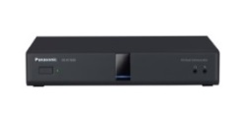
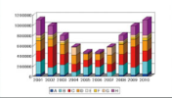
Selection for Content Sharing Method
This is new!
Dual stream and single stream as data sharing method can be selected
by remote controller during communication depending on the situation.
＜So far＞
＜Ver4.2＞
During communication, setting for dual stream and single stream can not be changed.
It is possible to share data with single stream by remote control during communication even if dual stream is set.
Sharing data by PC button on remote control
Dual Stream
Camera image(main)
Dual Stream
Camera image(main)
PC data(sub)
Band 1Mbps
512kbps
VC1600/VC1300
PC data(sub)
VC1600/VC1300
Dual stream can display data and camera image simultaneously, but data image quality decrease comparing to single stream.
It is difficult to share high image quality data/moving picture with dual stream.
Operation during communication
→Sharing data by PC button on remote control
Single Stream
PC data
Image quality decrease due to dividing band with data & camera
Band 1Mbps
1Mbps
Band
1Mbps
Sharing data image increase due to assigning band to PC data with 100%
VC1600/VC1300
512kbps
512kbps
It is possible to select data sharing method(single/dual stream) during communication
This function is useful for the case required higher image quality of data sharing.
It is useful for sharing moving picture required wide band.
Page 5

Slide 7
Single Stream
Transmit Image by switching Main Camera Image and PC Contents (or Sub-camera Image)
Condition for Single Stream Transmission
Turn H.239 OFF on HDVC setting.
Remote site VC system does not support H.239 protocol.
* In case of H.239 of HDVC setting is ON, input selection can not be made.
* VC1600/1300 do not support Composite Image transmission method.
or
or
Main（HDMI）
HDMI1
HDMI2
HDMI1
Main（HDMI）
Main Stream: Main Camera Image or PC Contents or Sub-camera Image
VC1300
VC1600
Main Stream: Main Camera Image
VC1300
VC1600
Sub（HDMI）
For PC Content Sharing
Non-supported devices of Dual Stream (HDVC series)
KX-VC300/600 with Version 2.40 or older
* After Version 3.00 can be received Dual Stream only.
HDVC Mobile for Android/iOS
HDVC Mobile for Windows
PC In
（RGB/HDMI）
Page 6

Slide 8

Multi Monitor Support
Triple Monitor Support (VC1600 only)
Recording by using HDMI3 interface
(VC1600 only)
PC Contents
Remote site
Local site
PC Contents
Remote site
HDMI1
HDMI2
HDMI3
HDMI1
HDMI2
Digital Recorder
DMR-T4000R
VC1600
VC1600
HDMI3
Dual Monitor Support (VC1600/1300)
or
Recording can be made by utilizing HDMI3 interface.
* Video Image of HDMI1 or HDMI2 + Audio of all sites.
* In Triple Monitor operation, it can not be used.
Remote site
PC Contents
Note: In case of Dual Stream + Dual/Triple Monitor condition, recordable video image will be PC Contents or Remote site video image.
HDMI1
HDMI2
VC1600/1300
Page 7

